Slide 1

Online Learning Management System: A Technical Overview
A technical overview of Online Learning Management System (OLMS), detailing its architecture, requirements, and key components.

Slide 2




Introduction and Project Overview
User Management
Course Management
Student and Instructor roles with tailored capabilities
Creation, modules, and assessment tools
Progress Tracking
Assessment System
Enrollment system with real-time updates
Interactive assessments with certificate generation

Slide 3
Functional Requirements
Student Capabilities
Instructor Capabilities
System Functions
Enroll in courses
Create courses
Automated tracking
View content
Manage content
Certificate generation
Take assessments
View student progress
Analytics dashboards
Track progress
Grade assessments

Slide 4
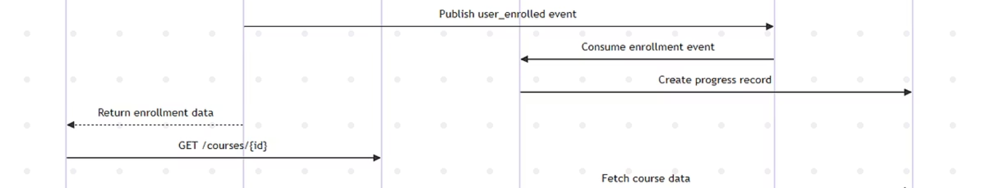
Performance & Scalability
Response Time
Throughput
All API calls target response within 2 seconds under normal load.
System designed to support 1000 concurrent users.
Scalability
Availability
Microservices architecture enables horizontal scaling.
Targeted at 99.9% uptime with robust fault tolerance.

Slide 5








Security & Reliability
Data Encryption
PII encrypted at rest and in transit
Authentication & Authorization
JWT-based with role-based access control
Data Backup & Recovery
Regular automated backups with rapid recovery
Error Handling
Comprehensive logging and monitoring

Slide 6
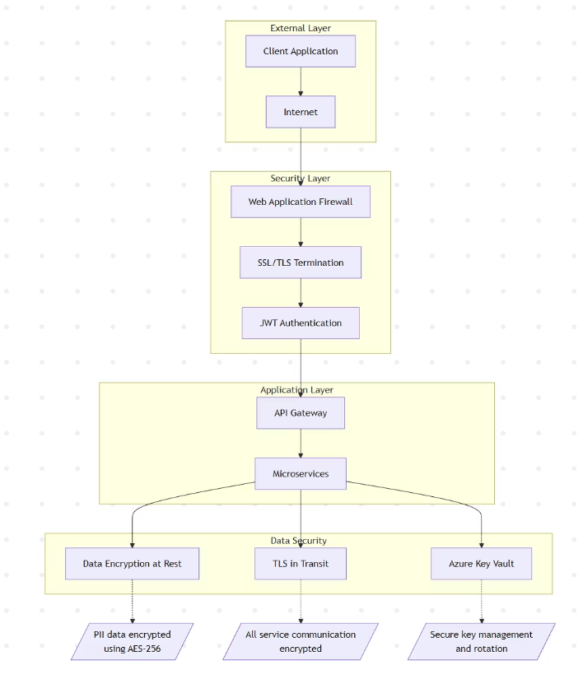




System Architecture Overview
Client Layer
Cloud Infrastructure
Microservices
Data Layer
Web Application, Mobile App, API Client
Azure with Application Gateway, Kubernetes Service
Course, User, and Progress Service Pods (3 replicas each)
PostgreSQL Databases with Redis Caching

Slide 7








Services Communication
User Service
Course Service
Handles registration and enrollments
Manages course creation and content
Progress Service
Azure Service Bus
Tracks completion and assessments
Central message queue for events

Slide 8
Database Schema Design
USERS & USER_PROFILES
1
Stores user details and profile information
2
COURSES & MODULES
Details of courses linked to modules and assessments
ENROLLMENTS
3
Records student enrollments in courses
4
PROGRESS_TRACKING
Monitors progress linked to assessment results
COMPLETION_CERTIFICATES
5
Stores details of issued certificates

Slide 9
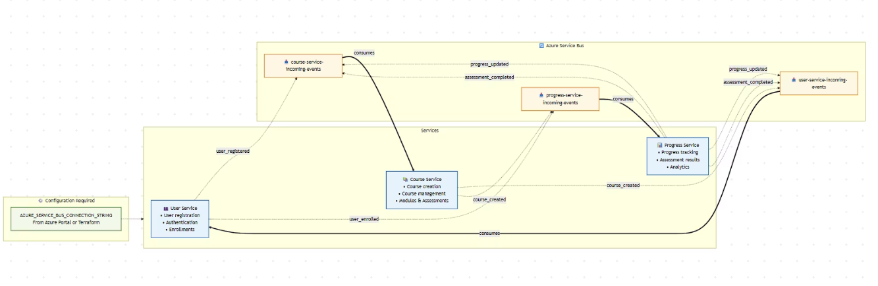



API Documentation Overview
Course Service
User Service
Progress Service
Manages courses, modules, and assessments with endpoints like GET /courses and POST /courses.
Handles authentication, registration, and enrollments via POST /auth/register and GET /users endpoints.
Tracks progress, manages assessments, and generates certificates through various endpoints.

Slide 10
Thank You for Attention
Sources to detailed docs and code: https://github.com/rcinos/cloud-lms/tree/main/course-service

